Slide 1
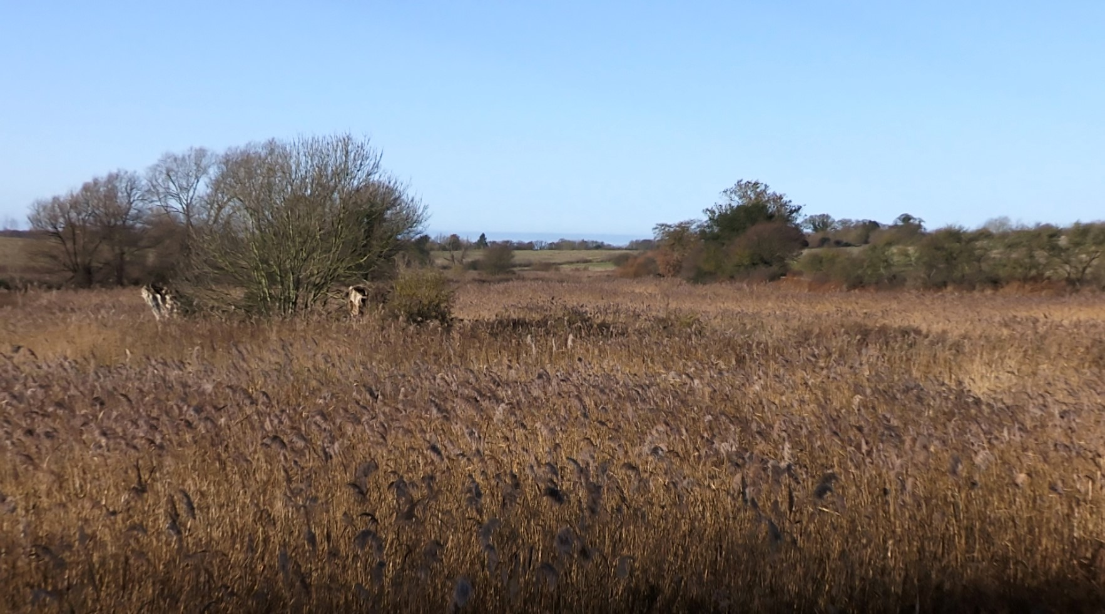
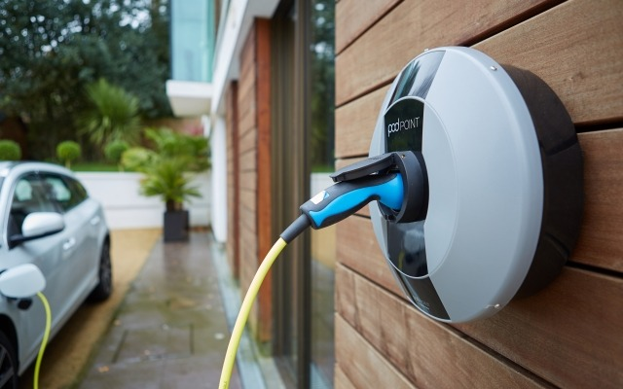

A green and diverse construction project
Sizewell C are carrying out an emissions audit of the project. We will then look to identify opportunities to reduce the carbon footprint of the construction and operation of the plant, through our supply chain.
This could include: logistics, transportation, on-site generation, through to catering contracts.
Through discussions with HMG and local authorities we are looking to promote local and regional sourcing strategies.
We are also keen to explore opportunities in and around the Sizewell estate, with local landowners and residents, to improve biodiversity and encourage clean, productive agriculture.
The nuclear industry has set ambitious diversity and inclusion targets and we are interested to explore how the local and regional supply chain can support this.
1

Slide 2
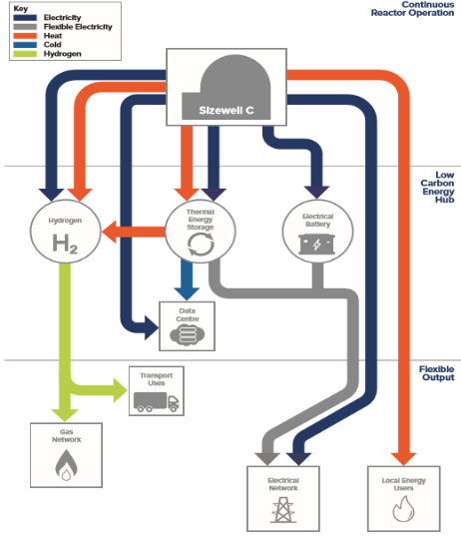
More than a nuclear power station: supporting decarbonisation beyond the power sector
Kick starting the Hydrogen economy, by a demo electrolyser potentially powered by SZB, which could be scaled up at SZC once the power plant is operational.
Direct Air Capture (DAC) can be located at the nuclear power station to give net negative lifecycle carbon emissions. Net Zero fuel can be processed from carbon captured by DAC, which can be combined with hydrogen produced by electrolysis.
Aligning with Freeports to create a ‘test bed’ with regulatory flexibility to deliver innovative low carbon technologies and support the decarbonisation of sectors such as shipping.
As part of an energy hub, new nuclear can provide even greater flexibility For example, on a windy day when offshore wind is producing enough electricity to meet demand nuclear can divert some of its output to other low-carbon activities.
Nuclear Plant
2

Slide 3











Sizewell C provides a strong platform to support the “green recovery”
Sizewell C is proud to be collaborating on a community led project to take the town of Leiston to net zero
This project will:
be community led
take a thorough, robust engineering approach
have sustainable and affordable business models
provide social mobility by training local people
be open source and collaborative
combine thinking and funding
3

